Slide 1
Case Study Tutorial
Wetting and Non-Wetting
Basics of Wetting

Slide 2
Three phase contact (TPC) zone
surface
G
L
bulk
S
contact line

Slide 3
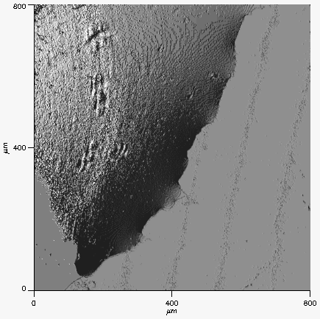
Three phase contact (TPC) line
droplet
steel surface

Slide 4
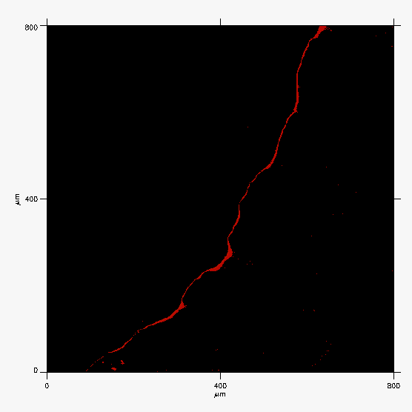
Three phase contact (TPC) line
droplet
steel surface

Slide 5
Capillary pressure
P_{e}
P_{i}
γ is the interfacial tension, R₁ and R₂ are the two principal radii of curvature

Slide 6
Young equation
γ_{LG}
γ_{SL}
Θ_{Y}
γ_{SG}

Slide 7
Hysteresis
Θ_{Y}
Θ_{r}
Θ_{a}
Viscous flow:
Hindered TPC (pinned)
Non-slip
Ideal flow: Barriereless TPC
Free slippage
Θ_{r} < Θ_{Y} < Θ_{a}

Slide 8
The TPC line resistance (hysteresis) is due to solid surface heterogeneities:
morphologic and/or energetic

Slide 9
Morphologic heterogeneity
"God created the solids, the devil their surfaces"
Wolfgang Pauli (1900-1958)
REAL SURFACES ARE ROUGH
The intrinsic contact angle at a rough surface is different from measured one:
Wenzel, Cassie-Baxter, wicking models

Slide 10
Topometric characterisation parameters
according to DIN EN ISO
flatness, waveness, roughness

Slide 11
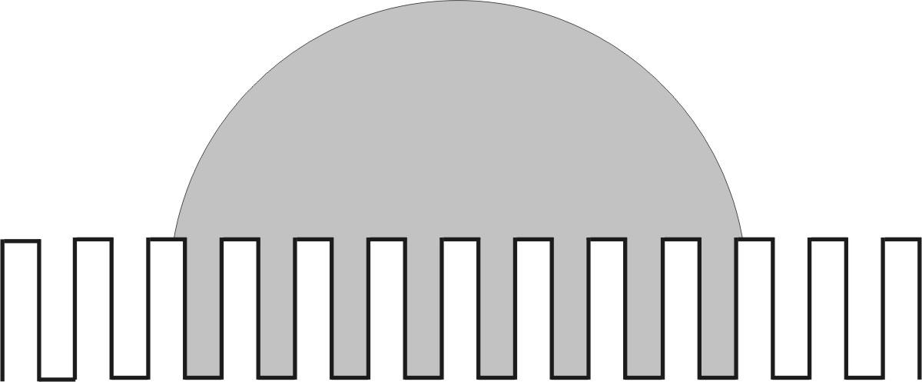
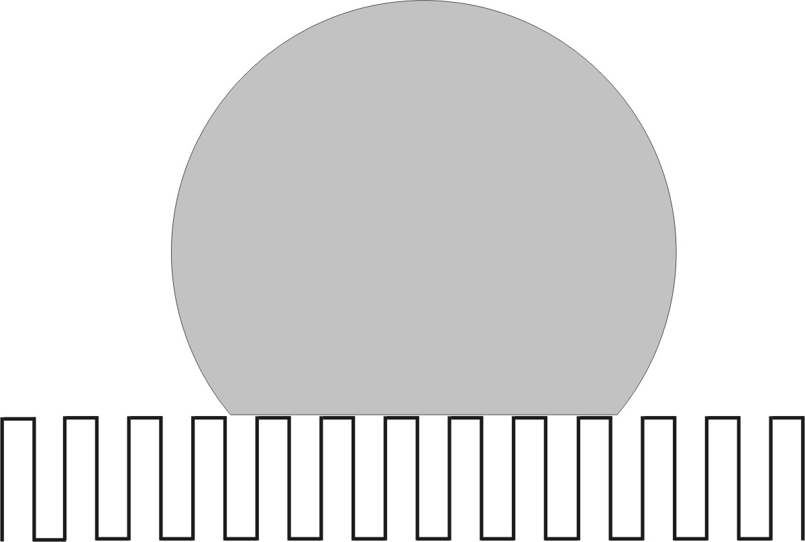
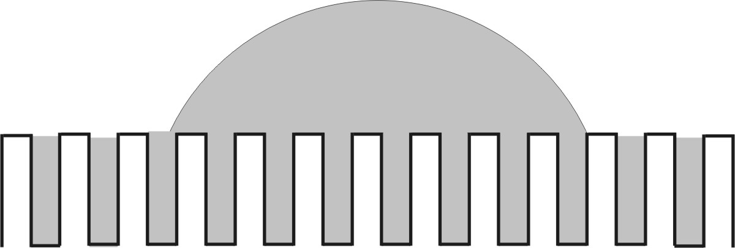
Morphologic heterogeneity
Wenzel
Cassie-Baxter
Bico et al. wicking
Johnson & Dettre in “Wettability”, Ed. by John C. Berg, 1993

Slide 12
Adhesion, viscous friction and contact line barriers have the same nature: van der Waals interactions
In the case of: - non-slip boundary conditions
viscous fluids - barrier contact line motion
  - TPC angle hysteresis
In the case of: - free boundary slippage
ideal fluids - barriereless contact line motion
- no TPC hysteresis (Young Model)

Slide 13
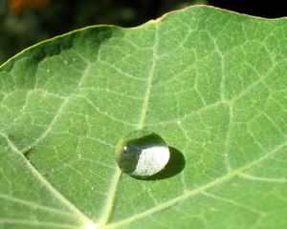
30 μm
30 μm
hydrophobic
hydrophilic
superhydrophobic

Slide 14

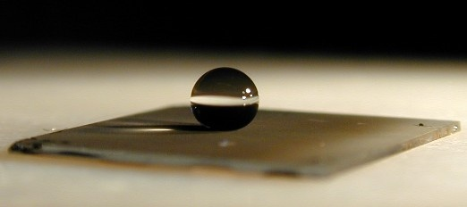
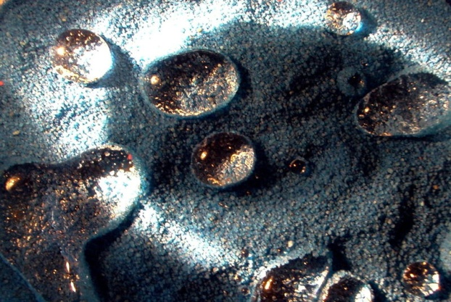
Super-hydrophobicity
We learn from nature ...
... and want to mimic
adhesives
coatings
în microelectronics

Slide 15
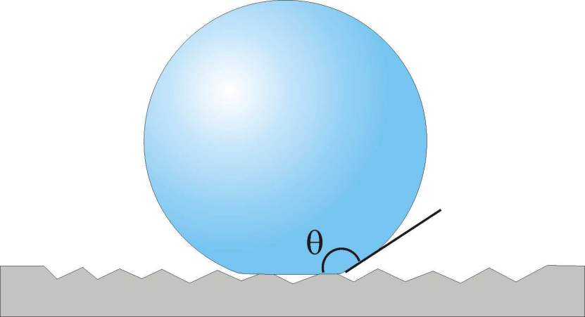
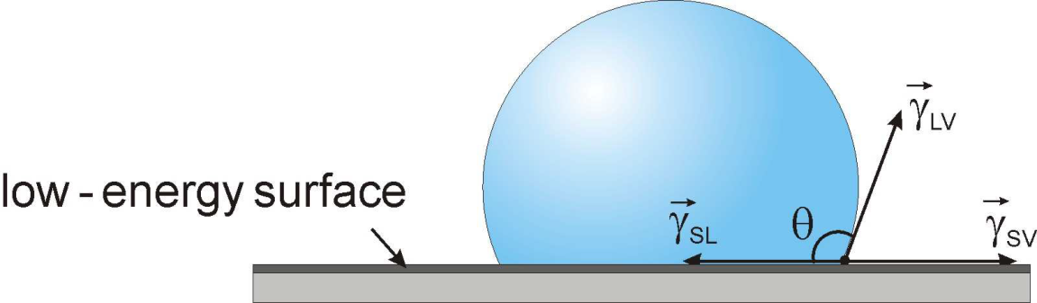
Super-hydrophobicity
Wettability can be manipulated through
  changes in surface energy
changes in surface morphology/topography (roughness, geometry)
CA ≥ 150°
CA = 90 - 120°

Slide 16
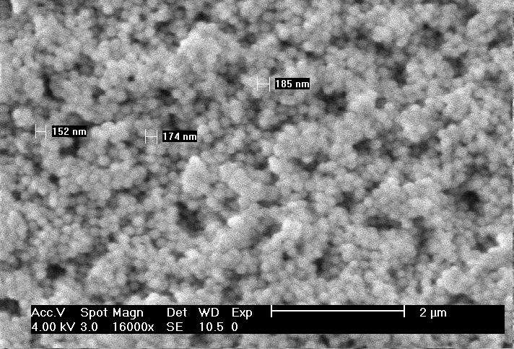
Super-hydrophobicity
Structure of rough surfaces can be:
Regular
Irregular (Random)
Hierarchical (Fractal):
L and l are the upper (of several micrometers) and lower limit (particle diameter) scales of the fractal behaviour on the surface
D is the fractal dimension

Slide 17
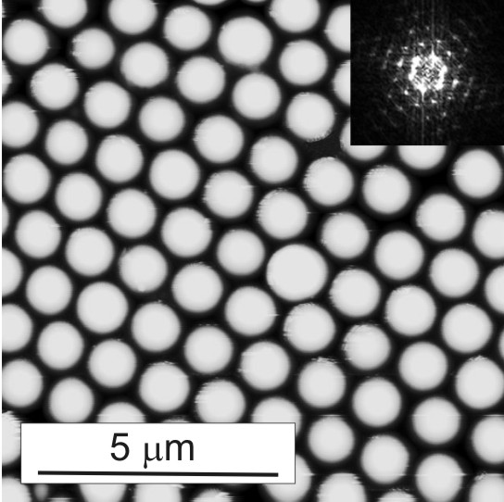
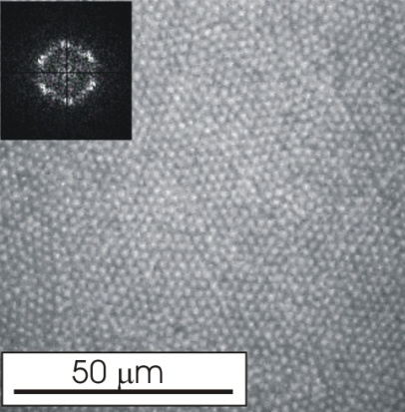
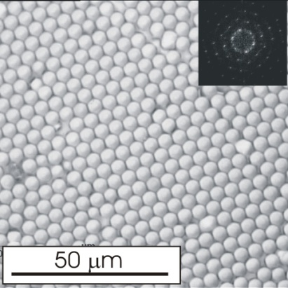
Surface modified by particles: Regular Structure
R = 200 nm
R = 1 μm
R = 2.4 μm
R = 5 μm
The height roughness (not the roughness factor) influences wetting

Slide 18
h
a
a
1 Under what condition is the Wenzel regime more stable than the Cassie-Baxter regime?
Wenzel, 1936
Cassie-Baxter, 1944

Slide 19
h
a
a
1 Under what condition is the Wenzel regime more stable than the Cassie-Baxter regime?
Wenzel roughness factor
Wenzel CA
Cassie-Baxter CA

Slide 20
h
a
a
1 Under what condition is the Wenzel regime more stable than the Cassie-Baxter regime?
If the liquid touch only the top of the surface, then f = ½ and r_{f} = 1
Wenzel regime more stable if
<
>
Wenzel regime is always more stable if
< 90°

Slide 21
h
a
a
2 Under what condition can this surface become non-wettable, i.e. superhydrophobic with a ?
CA > 150°
<
<
<
>
but

