Slide 1
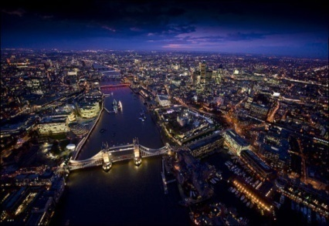
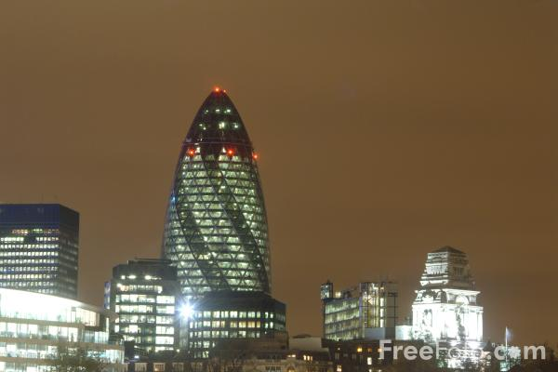
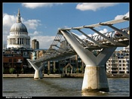

Neutron Reflectivity study of interfaces
Zarbakhsh
a.zarbakhsh@qmul.ac.uk
Queen Mary
University of London
              COST Action D43
              Colloid and Interface Science for Nanotechnology
Sofia 2011

Slide 2
A
Neutron Reflectivity
application of neutron reflectometery in resolving these buried interfaces
Fluid-Fluid interface and why and how ?
Application of neutron reflectometery in resolving these buried interfaces
Typical results
B
Conformation of alkylated azacrown ether at;
    Air - water interface,
    Oil - water interface.
    & the role of fatty acid,
    Structure studies of lipids at the oil-water interface
C
Concluding remarks and future work.

Slide 3

Neutron Reflectivity
The Neutron
Wave-particle duality
m_{n}
v
λ
m_{n} = 1.674 x 10⁻²⁷ kg
h
Thus:
λ
=
m_{n}v
λ
~
10⁻¹⁰ m
de Broglie (1924)
E
~
k_{B}T
Neutrons scattered by nucleus
isotopic substitution - labelling
b_{H} = -3.74 x 10⁻¹⁵ m
b_{D} = +6.67 x 10⁻¹⁵ m
complex sample environment
repetitive measurements
nuclear reactors or spallation sources

Slide 4
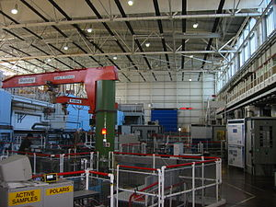
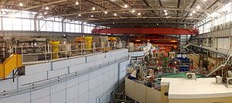
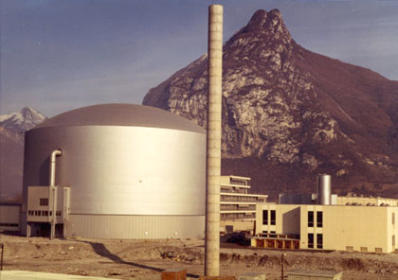
The Spallation Neutron
Reactor Source

Slide 5
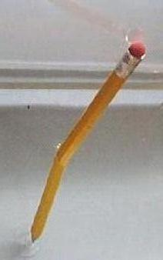

Neutron Reflectivity
Reflectivity
Theory
A newer version of well known phenomenon
Refraction of light
r
Less dense
(air n =1 )
i
Dense (n)
In French, Snell's Law is called "la loi de Descartes"
In case of neutron for most materials n <<1
1. Principle of Optics
2. Quantum approach
A = Nb/(2π)
C = Nσ_{A}/(4π)
Where N is the atomic number density of medium
B is the bound atom coherent scattering length.
The term σ_{A} is the absorption cross-section
For polymeric species and solvents of low relative molecular mass Nb
can be replaced by the scattering length density of the polymer segment or solvent molecule, ρ.

Slide 6

Neutron Reflectivity
The neutron
Reflectivity
θ < θ_{crit}
θ = θ_{crit}
θ > θ_{crit}
I(θ)
Reflection
&
Refraction
Reflection
θ_{crit}
θ

Slide 7
Neutron Reflectivity
The Neutron
Reflectivity
Structural information
r
to the surface
Simplest Case
Complex Case
ρ
ρ
d
d
Lateral structure give rise to Off - Specular

Slide 8
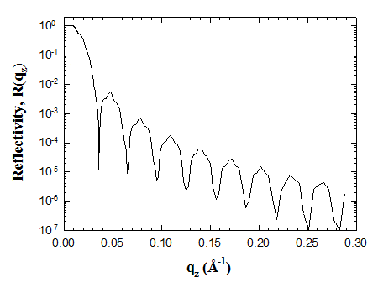
Neutron Reflectivity
The Reflectivity
Data Analysis
Ideal world
ρ
d
Optical matrix method
The transmission and reflection from one layer to the next is described as a matrix multiplication product.
ρ
Proposed a model and compare with the data
d

Slide 9


Scattering length density A²
Critical angle
Contrast variation

Slide 10
Neutron Reflectivity
The neutron Reflectivity
Applications
Surface Chemistry
Surfacatnts, Polymers, Protein, Lipids
at air –water
solid –liquid and
liquid –liquid interfaces
Solid surfaces
Thin films, multilayers, polymers
Magnetic sample
Magnetic multilayers, superconductors
and thin films

Slide 11
A
The Liquid/Liquid Interface Why and How?
Why
Transport properties of cell membrane
Stabilisation of emulsion
Mixed surfactants and cold water cleaning
Proteins (and surfactants) at Oil / Water: Important in biological & food systems
Proteins stabilise a diverse range of colloids including: blood, ice-cream, milk
How
Sum Frequency Spectroscopy
x-ray reflectivity
Neutron reflectivity

Slide 12
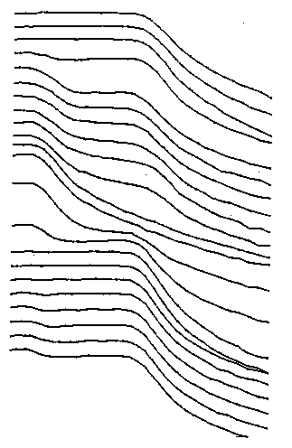

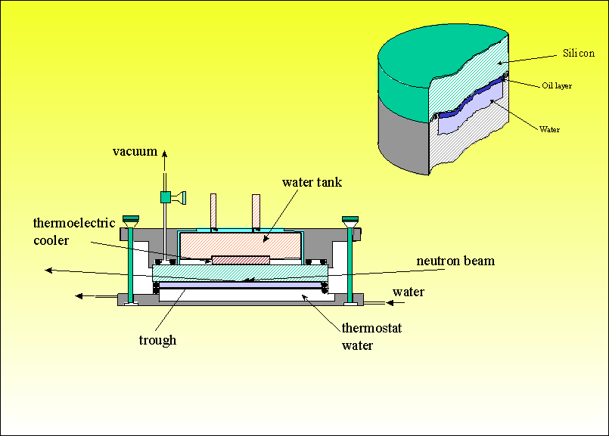
Condensation Method
6
6
6
Neutron beam
water
4
4
4
Oil -water
oil
Log Reflectivity
Log Reflectivity
water
Log Reflectivity
2
2
2
thick oil
Thermostatted plate
Thermostatted vapour-tight vessel
0
Oil -water
0
0
Thermostat 1
Thermostat 2
1.00
1.50
2.00
2.50
few micron oil - water
1.00
1.50
2.00
2.50
1.00
1.50
-2
-
2.00
2.50
2
1
-
Q x 10
1
2
/
/
Å
Å
-
Q x 10
1
/
Å
Q x 10 ^{– 2} / Å⁻¹
Method: Relies on balancing the condensation and drainage
rates of the oil film
Limitation: the maintenance of a uniform condensed oil layer is
a non-trivial and very time-consuming task. the technique is restricted
to the study of volatile oils limited contrast can be used.
Spin-Freeze method
Hydrophobe silicon surface: Chemically modify using
trichlorosilane from chloroform Spread oil using a
spinner. Freeze rapidly, assemble cell and introduce aqueous phase.
Hydrophobic silicon surface
Spread hexadecane
Spin (2000 rpm for 20 s)
Cool block to T < 18 ºC
Assemble cell
Warm block to T >18 ºC
Measure reflectivity
“A new approach to measuring neutron reflection from a liquid/liquid interface”
A, Zarbakhsh, J. Bowers and J.R.P.Webster. M. Sci. Technol, 10, 738-743
1999.
Thickness of oil film is determined by mass of oil added and spinning speed

Slide 13
Experimental & analysis
Use a supermirror to change Q
Film stable/reproducible
R₁
Si
θ = θ₀
Oxide
d₁
(CH₃)₃-layer
d₂
Oil
θ_{oil}
d_{oil} = d₃
R₂
Oil
θ_{oil}
n interface
layers
d₄
d_{n}
Aqueous subphase
T = exp(-χl)

Slide 15
Interfacial width at bare hexadecane-water interface
The reflectivity can be written
Ln(R/R_{F}) = -Q_{z}Q_{T}σ²
The interfacial width, σ
σ₀ including the intrinsic
σ_{CW} capillary-wave contribution
σ₀
σ
oil
σ_{CW}
water
interfacial tension varies as
γ / mN m^{–1} = 54.5 – 0.076(T/K–298)
NR σ₀ = 6.0 ± 1.0 Å
“Width of the hexadecane–water interface: A discrepancy resolved”
Ali Zarbakhsh*, James Bowers, and John Webster.
Langmuir, 21 (25), 11596 -11598, 2005.
XR σ₀ = 6.0 ± 0.2 Å*
Expected σ₀ = 5.55 Å

Slide 16
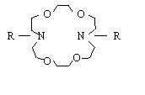
B
Macrocyclic ligands at the air-water and the oil-water interface
Cationic transport carriers in different extraction base techniques
The Langmuir films of these azacrown ether have potential in chemical
sensing and molecular electronics applications
They can act as a good representative of biological transport systems
R = C₁₆H₃₃
Stabilization of alkylated azacrown ether by fatty acid at the air-water interface.
Zarbakhsh A, Campana M, Webster JR, Wojciechowski K
Langmuir 26(19):15383-15387 05 Oct 2010

Slide 17
Buffle et al. used the alkylated azacrown ethers in conjunction with fatty acids for transporting heavy metal ions (Cu(II), Cd(II), Pb(II)) against their concentration gradient in so called Permeation Liquid Membrane (PLM) devices. A typical PLM device consists of a hydrophobic membrane separating two aqueous compartments between which the transport of metal ions takes place. The process involves thus two extraction steps - one at each aqueous-membrane interface. The membrane could be either unsupported (bulk organic phase), or supported in the pores of a thin inert polymer support. In either case the membrane consists of a solution of the carrier (e.g. a mixture of azacrown ether and fatty acid) in a nonpolar solvent.
Source (aqueous medium + metal species (M)) | Membrane (organic medium + carriers (C)) | Strip (aqueous medium + Complexing agent (S))

Slide 18
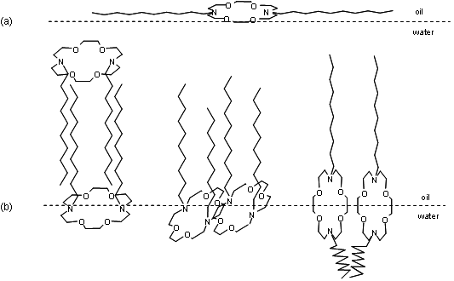
X-ray reflectivity : toluene -water interface
Surface tension isotherm can not be understood
using a simple Langmuir or Frumkin model
(a)
Oil
ACE10
Water
A possible expanded model
Reoriented model
(b)
Oil
Water
X-ray data could not distinguish between these
Possible models.

Slide 19
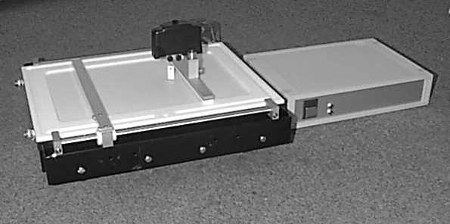
Air –water interface experiment
Two contrasts
1. Air – null reflecting water
R = C₁₆D₃₃
2. Air – D2O

Slide 20
Reflectivity data for contrast 1 (air-null reflecting water) interface for a solution of d-ACE-16 measured at 1.5°. The solid lines correspond to a single layer model with film thickness 21.5 ± 0.5 Å.
25.7Å
21.5 ± 0.5 Å

Slide 21
Analyses of reflectivity data measured for contrast 1: (a) π vs area per molecule for d-ACE-16 estimated from the area of the trough (b) the area per estimated from the area of the trough as a function of the area per molecule obtained from the fits to the neutron profiles.

Slide 22
Reflectivity data for contrast 2 (air-D₂O) interface for a solution of d-ACE-16 measured at 1.5°. The solid lines correspond to a single layer model with film thickness 21.5 ± 0.5 Å.

Slide 23
Scattering length density profiles used to model the contrast 2 (for d-ACE-16 at the air-D₂O)

Slide 24
Oil –water interface experiment
R = C₁₆D₃₃
Two contrasts
1. Si contrast matched oil – Si contrast matched water
2. Si contrast matched oil –D2O
1
2
silicon
R_{tot}
silicon
R₁
θ
oil
φ
R₂
d
oil
water
water

Slide 25
R₁ Part of reflectivity
R₁
Si
θ = θ₀
Nb = 2.07 x 10 ^{–6} Å^{–2}
Oxide
d₁ = 8 Å Nb = 3.40 x 10 ^{–6} Å^{–2}
(CH₃)₃-layer
d₁ = 5 Å Nb = 0.50 x 10 ^{–6} Å^{–2}
θ_{oil}
Oil
Interlayer roughness, each of 2.2 Å

Slide 26
Reflectivity data measured at 1.4°, for contrast 3 (Si - hexadecane scattering length density matched to the Si - aqueous solution with scattering length density matched to Si), for a series of spread amounts for the d-ACE-16. The solid lines correspond to a single layer model with film thickness 29.0 ± 2.0 Å.

Slide 27
The fitted adsorbed amount deduced from contrast 3 for the d-ACE-16 at the oil-water interface is plotted as
a function of spread amount. The dash line shows the idealised line.

Slide 28
Reflectivity data for the contrast 4 (Si - hexadecane scattering length density matched to the Si - D₂O) for a series of d-ACE-16 spread amounts measured at 1.4°. The solid lines correspond to a two-layer model (17 Å at the hexadecane side of the interface and 38 Å at solution side of the interface.

Slide 29
Scattering length density profiles used to model the contrast 4 data

Slide 30
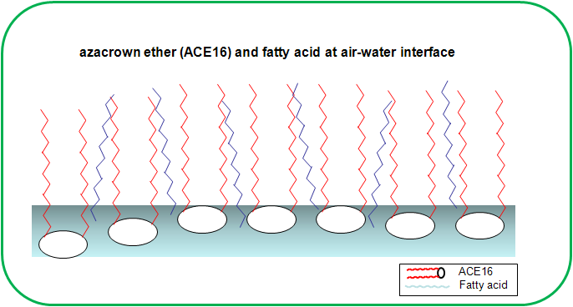

Slide 32
Structural study of lipids at the oil-water interface

Slide 33
Volume fraction profiles 0.26 & 0.06 mg m⁻²

Slide 34
Oil phase ( Nb = 2.07 x 10⁻⁶ Å⁻²)
d2
d3
d1
d2
d1
Aqueous phase D₂0 (Nb = 6.35 x 10⁻⁶ Å⁻²)
Increasing spread amount

Slide 35
C
Final Remarks
► Application and refinement of a method for structural studies at a
liquid-liquid interface using neutron reflectometery.
► Absorption isotherms and molecular conformations have been deduced.
► We have recently extend these studies to lipids conformations
and interactions at Liquid – Liquid interfaces.
► We have also working on application of series of isotopic substitutions
to resolve the distribution of oil and water at these important interfaces.

Slide 36
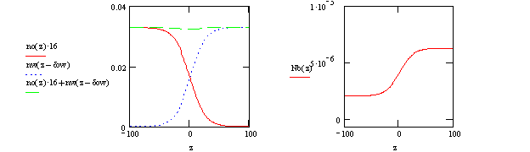
Partial structural study at the oil-water interface
Contrast hexadecane water
1 4e-6 Å⁻² D2O
2 4e-6 Å⁻² H2O
3 4e-6 Å⁻² 3e-6 Å⁻²
4 CMSi D2O
5 CMSi H2O
6 CMSi 3e-6 Å⁻²
a) Possible number density profiles of water (nw) and oil (no). The oil number density is per methylene unit. b) Corresponding scattering length density profile. The width of the scattering length density profile is ~5Å which agrees with theory and our previous neutron experiment.

