Slide 1
SANS at interfaces and in bulk systems under shear
Henrich Frielinghaus
JCNS c/o TUM, 85747 Garching

Slide 2
Surfactants
Ionic // Coulomb
Van Der Vaals
Hydrogen Bonds
Teflon / Flourinated Carbon Molecules

Slide 3
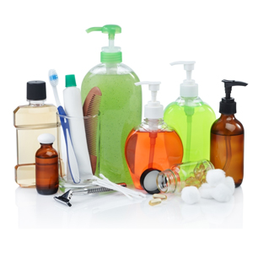
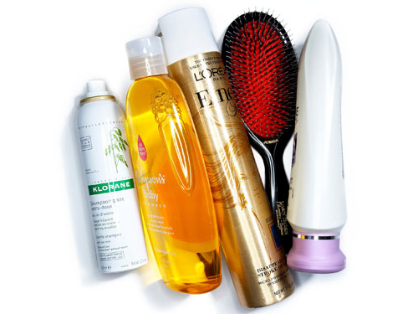
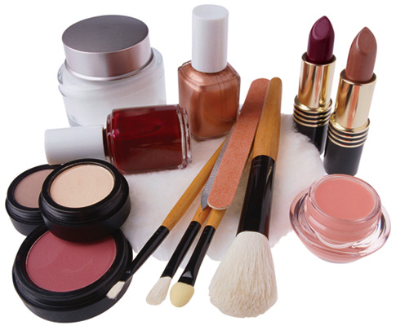
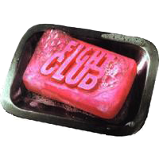
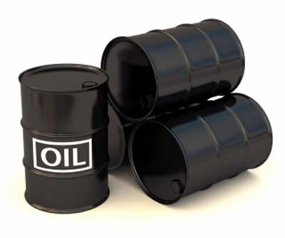
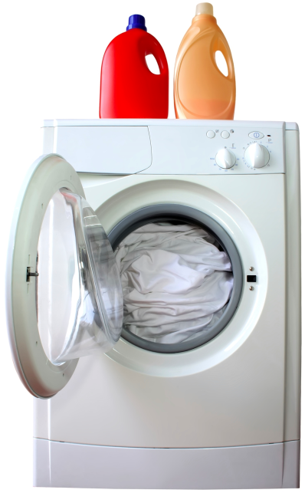
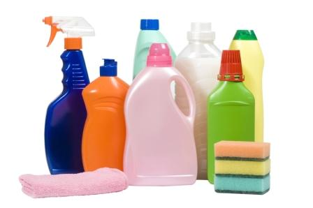
Applications of Surfactants
Hair care
Personal care
Cosmetics
Detergents
Enhanced oil recovery

Slide 4
Macroscopic Volumes
water
CMC

Slide 5
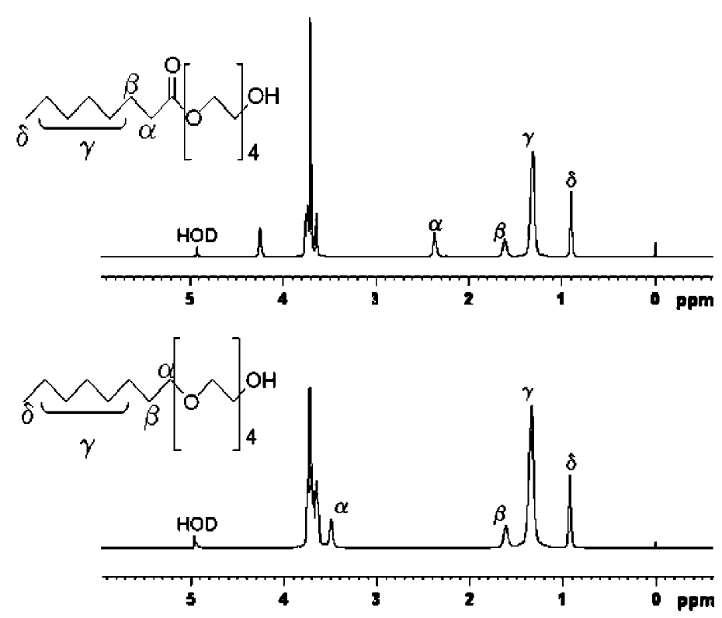
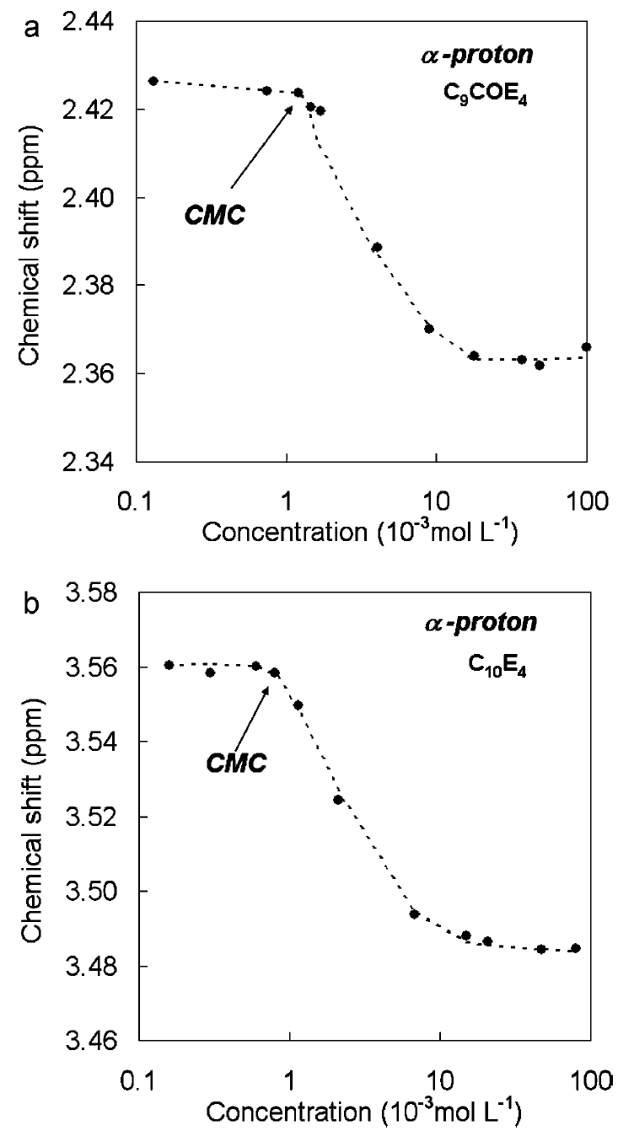

Slide 6
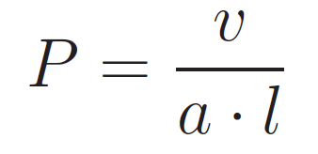
Packing Parameter
cone
wedge
cylinder
P = 0 .. 1/3, 1/3 .. 1/2, 1/2 .. 1, 1

Slide 7
Symmetry:
Entropy: Finite Length Finite Area
Shape Curvature Undulations Undulations

Slide 8
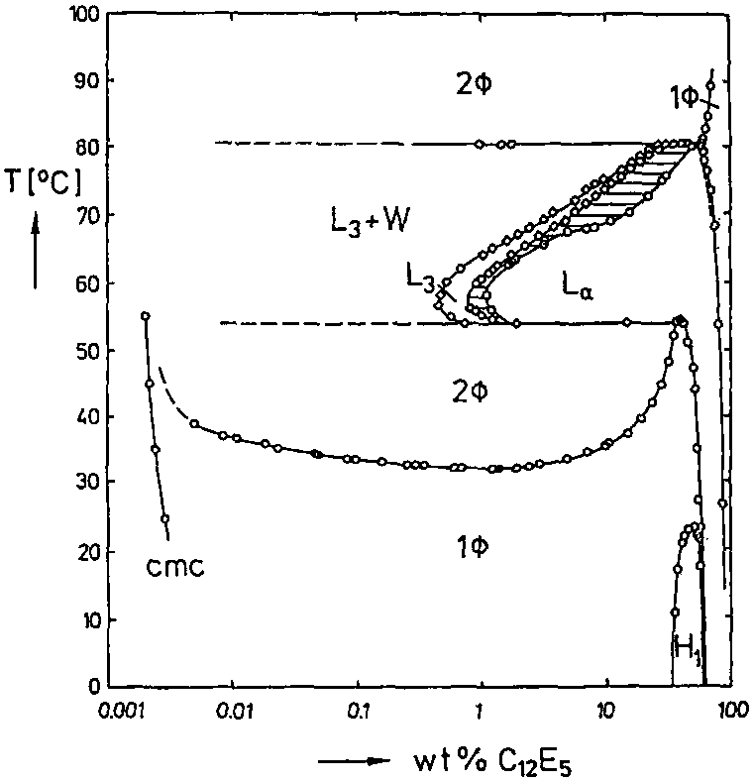

Slide 9
L₃
L_{α}
H₁

Slide 10
Interactions
Steric Repulsions
Coulomb Interactions
Symmetry:
Cubic, hexagonal, lamellar…
Entropy:
Distortions
Soft Matter Classical Hard Matter
Soft Potentials Coulomb Potentials
High Entropy Low Entropy

Slide 11
Microemulsions
Stability !!!
Water: H₂O Oil: Decane
Surfactant: C₁₀E₄
Micelles
Film
Water
Oil

Slide 12
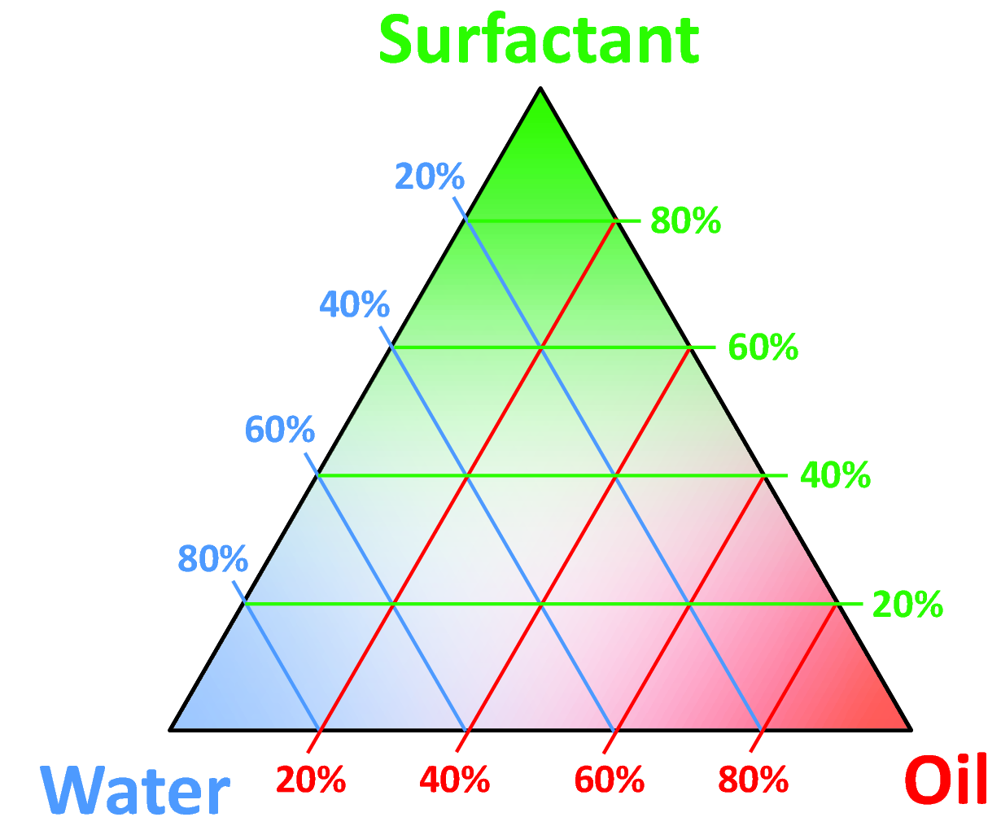

Slide 13
Bicontinuous Microemulsion
1µm

Slide 14
Larson

Slide 15
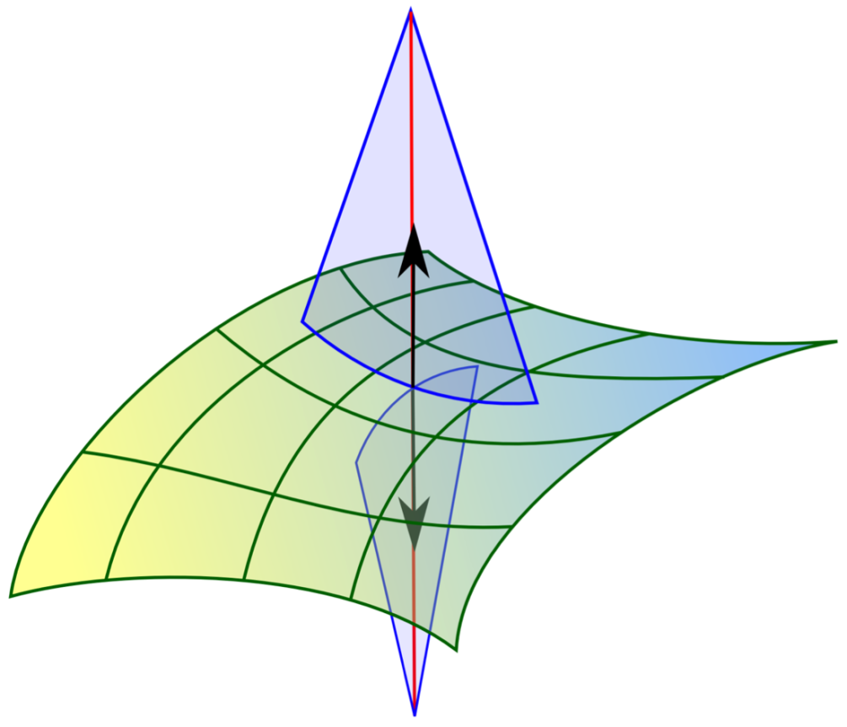
Free Energy
R₁
c₁ = R₁⁻¹
c₂ = R₂⁻¹
R₂

Slide 16
Phase Diagram f. Small Concentrations
γ⁻¹

Slide 17
Interactions

Slide 18
Oil Surfactant Water

Slide 19
Translational Entropy
N: lattice sites
k: species A
N-k: species B

Slide 20
Summary: Microemulsions
From Bulky Surfactant Molecules → Surfactant Film
* Packing Parameter * Helfrich Energy
Simple Shapes (diluted system)
Liquid Crystalline Phases

Slide 21
Measurements

Slide 22
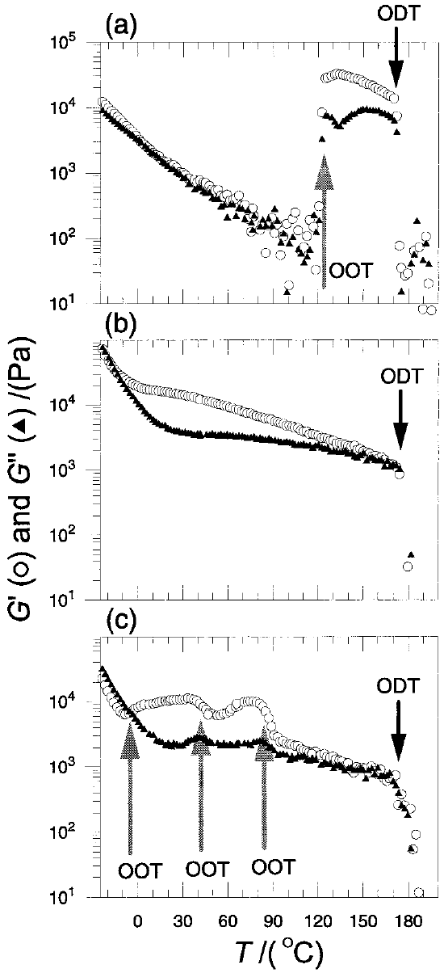
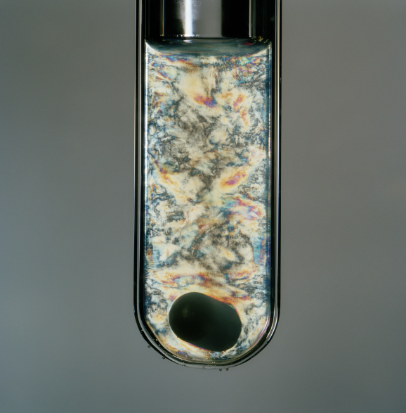
Rheology
Optical Measurements
Crossed Polarizers
Anisotropic Domains

Slide 23
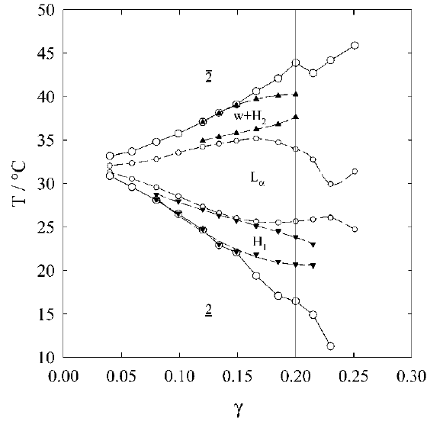
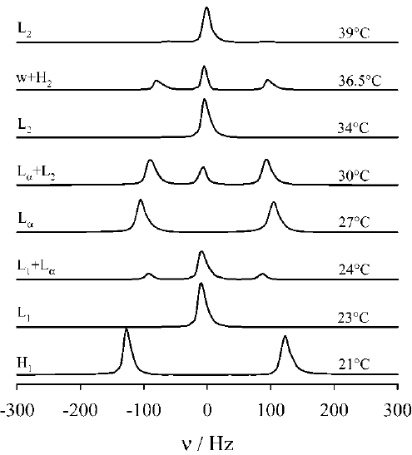
NMR - Microemulsion

Slide 24
Small Angle Scattering:
Detector
Collimation
Incident
Beam
Θ
Monochromator
Sample
Intensity

Slide 25
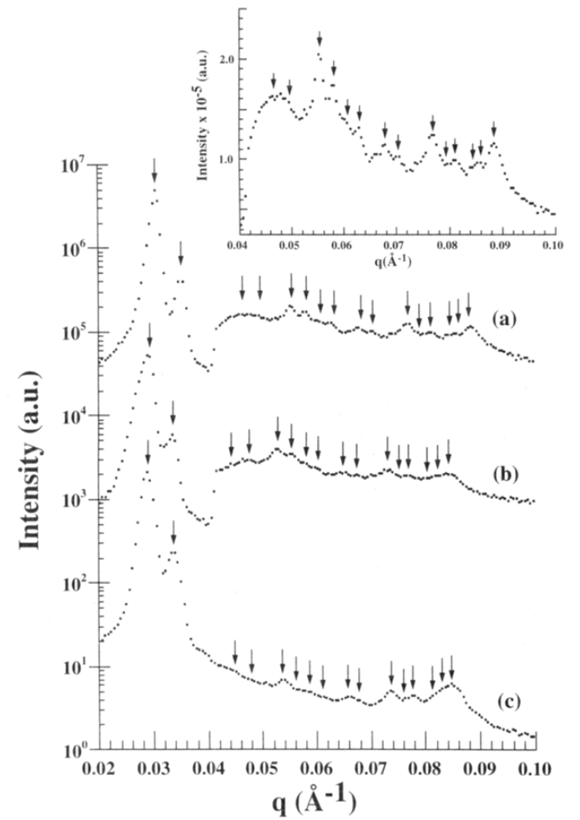
SAS
PS-PI
PEO-PB

Slide 26
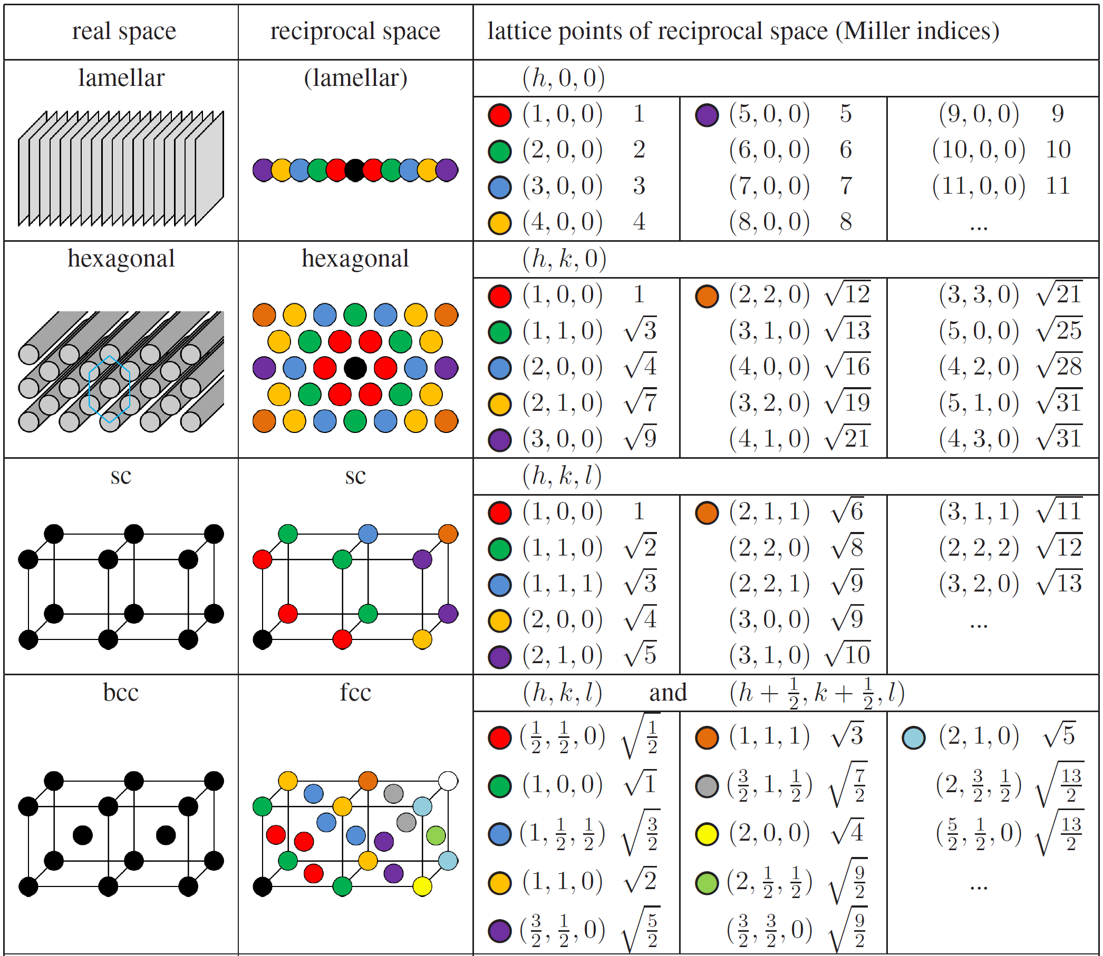

Slide 27
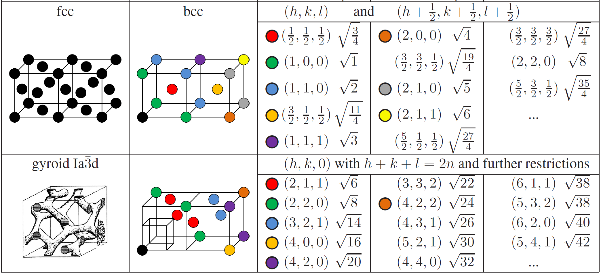

Slide 28
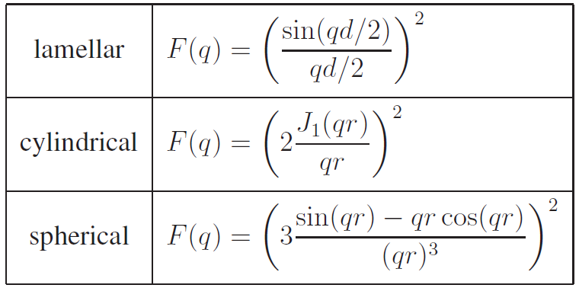
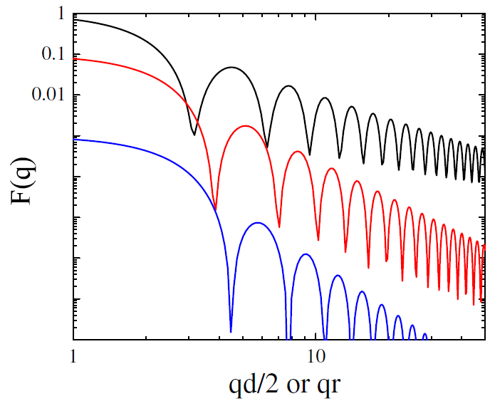
Formfactors

Slide 29
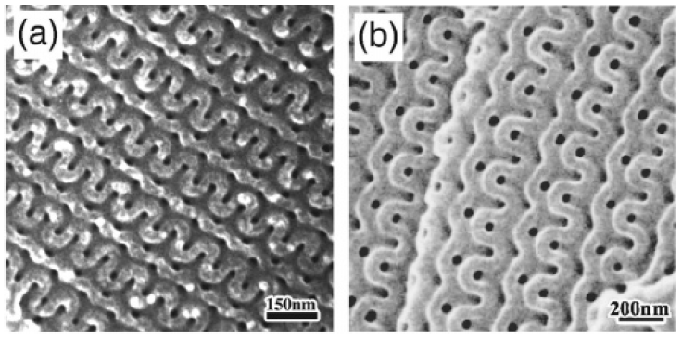
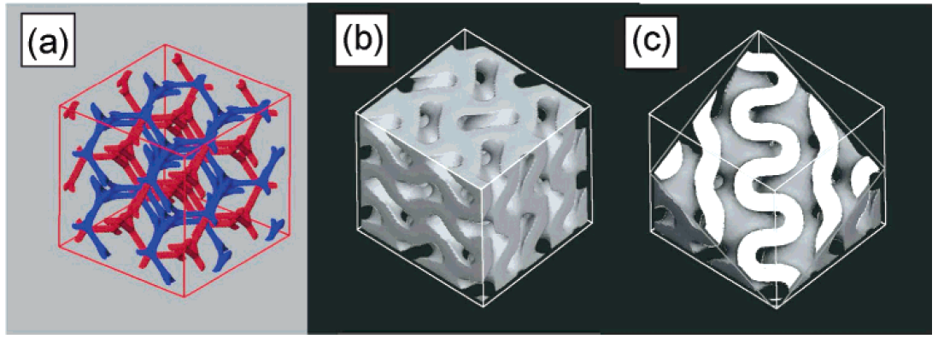
TEM

Slide 30
Summary Measurements
Optical
NMR
Rheology
Relative Viscosities
Frequency sweep
Small Angle Scattering
For many peaks: High accuracy
For indistinguishable peaks: Esoteric
TEM
Many cuts needed
isotropic / anisotropic
quick and easy
powerful
(single crystals)
…
further extension

Slide 31
Scattering from polymeric systems
Wormlike Micelles
Polymer Micelles

Slide 32
PEP₁₀-PEO₁₀ and PEP₂₂-PEO₂₂
PEP₁-PEO₁

Slide 34
Wormlike Micelles or Polymer
PS in CS₂
water/isooctane/lecitin

Slide 35
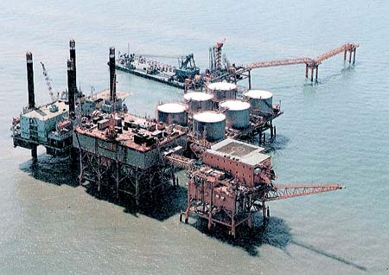
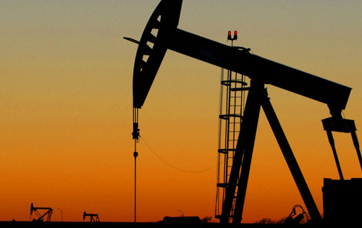
Oil Production
Aqueous Surfactant Systems are used for:
Drilling Fluid
Secondary/Tertiary Oil Production
Fracturing Fluid

Slide 36
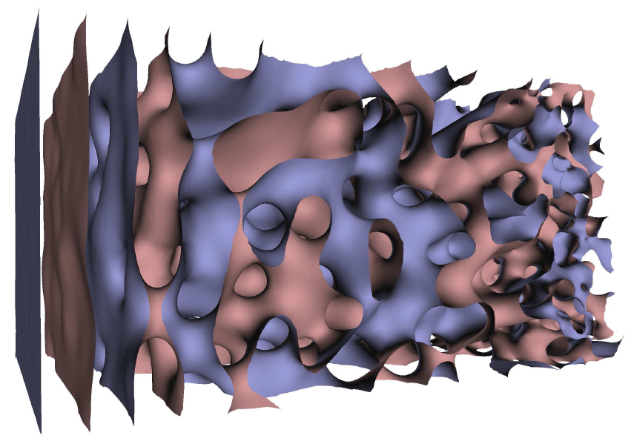
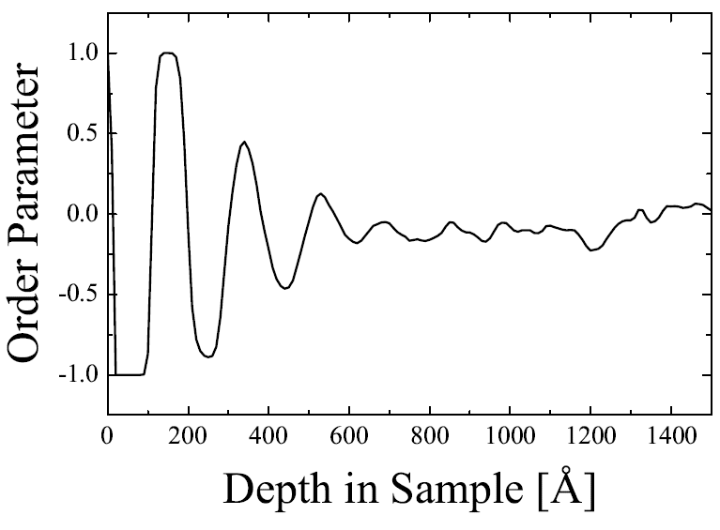
Simulations (M. Belushkin)
Single order parameter:
+1: Oil
-1: Water
0: Surfactant
Lamellar order decays !!!

Slide 37
The System
Water: D₂O, H₂O (41.5%vol)
Oil: Decane (41.5%vol)
Surfactant: C₁₀E₄ (17.0%vol)
Temperature ca. 25°C
The Cell
n
15 cm
Silicon
2 cm
0.1°
Cd
Cd
0.5 mm
Glass with Boron

Slide 38
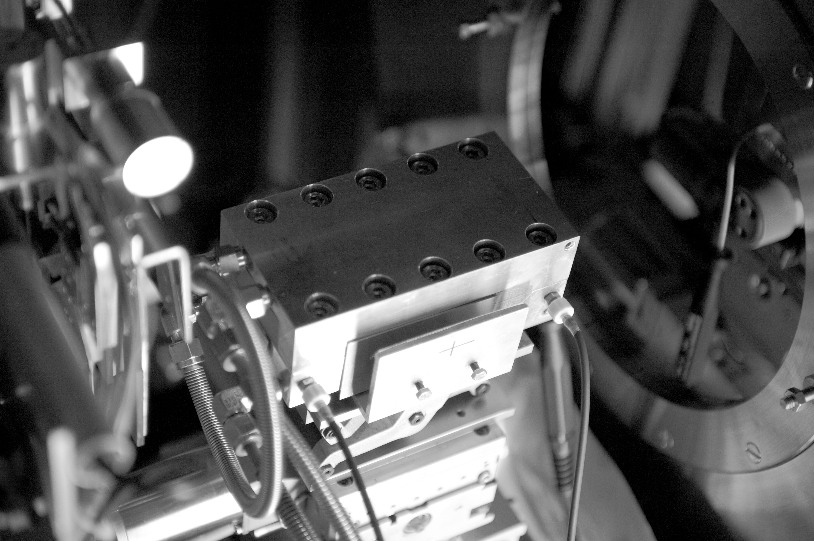
The Cell

Slide 39
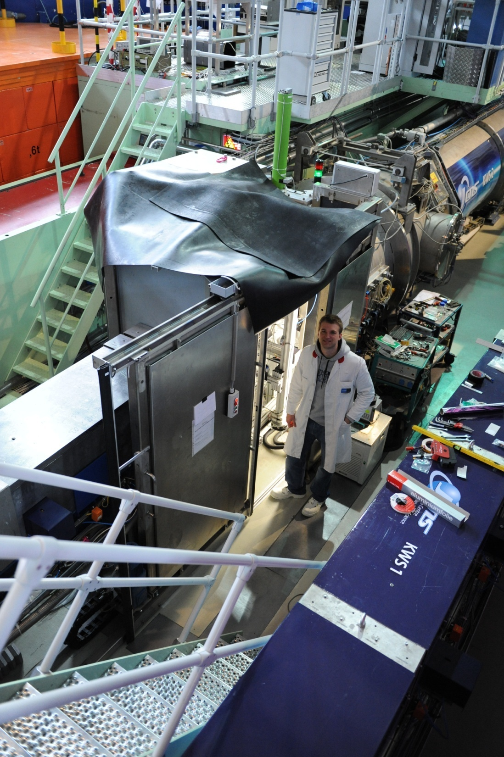

Slide 40
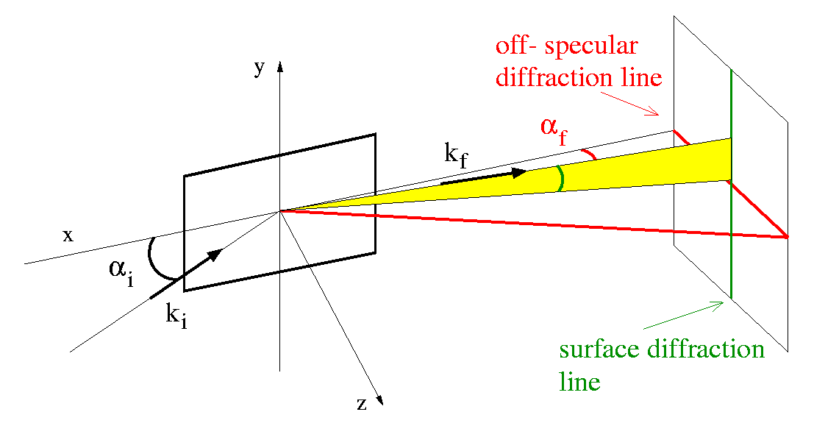
Grazing incidence:
θ
Reflect.: 1 µm < ζ// < 20 µm
GISANS: 2 nm < ζ// < 600 nm
(large θ_{y}, α critical angle)
α might be large...

Slide 41
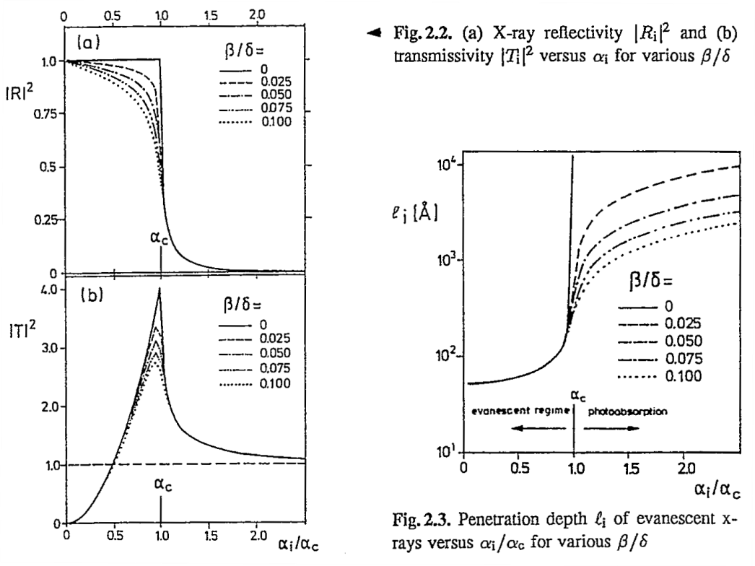
Evanescent Wave: the depth information

Slide 42
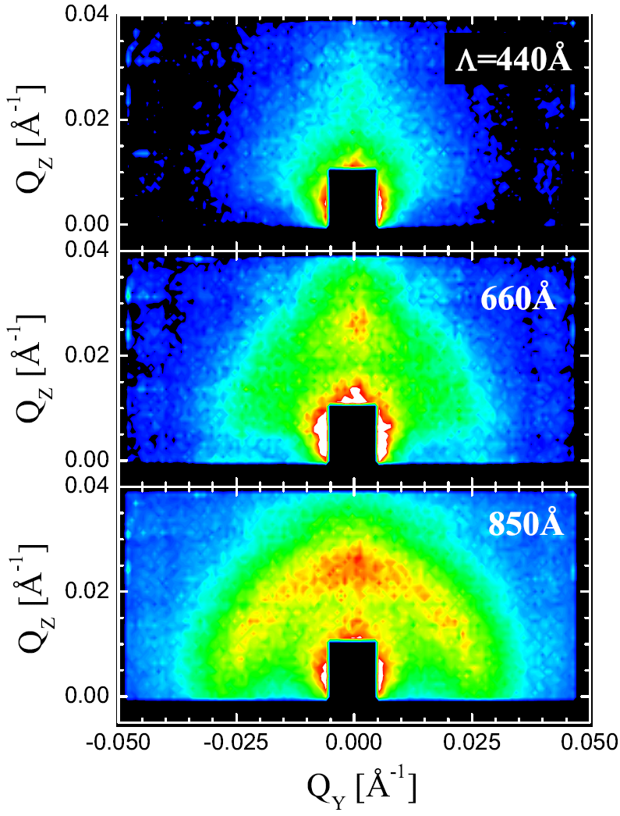
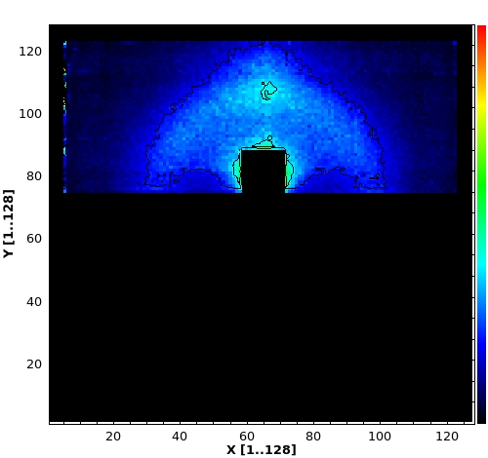
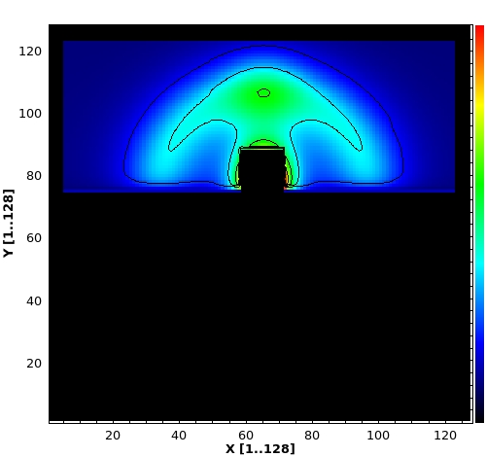
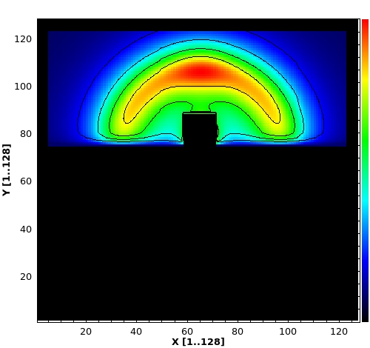
Measurements vs. Fits

Slide 43
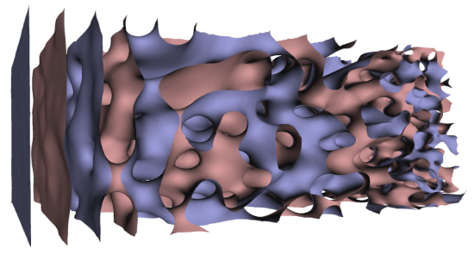
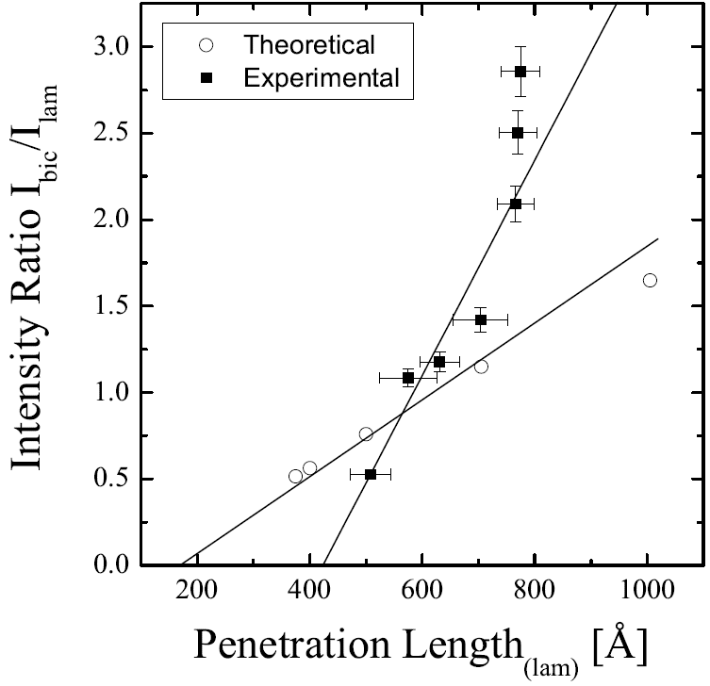
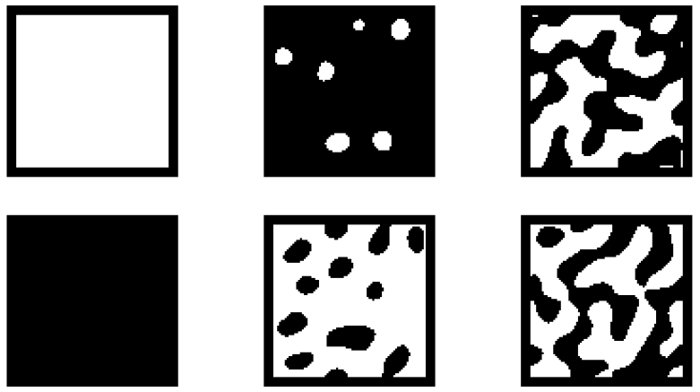
Results from GISANS
Lamellar: Peak
Isotropic: perforated lam.
+ bicontinuous

Slide 44
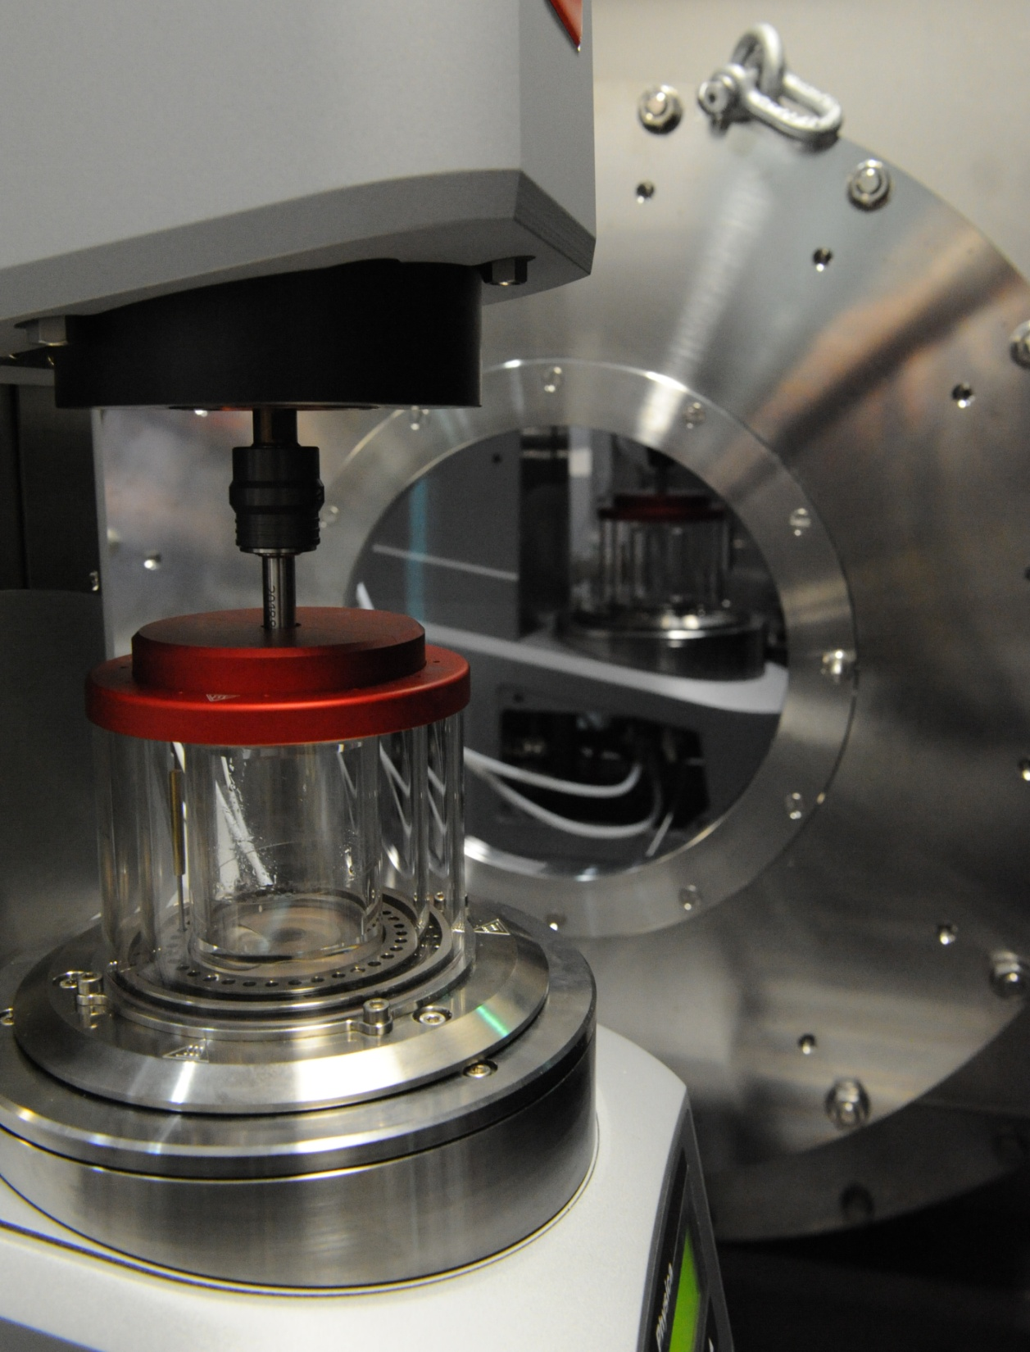
n
n

Slide 45
Microemulsion with Unsymmetric Polymer
WATER

Slide 46
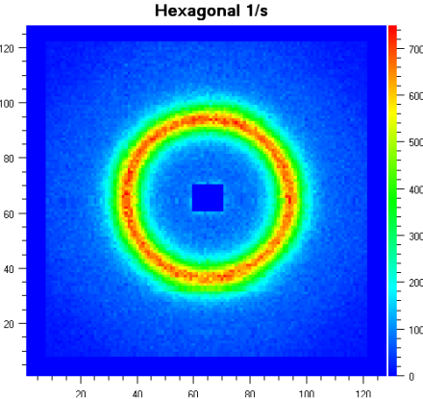
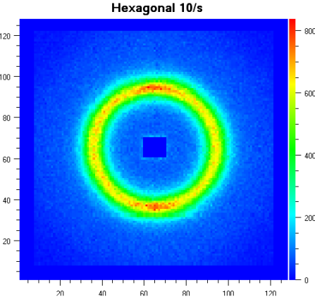
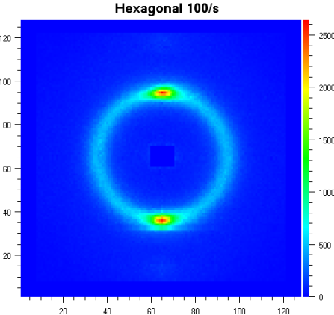
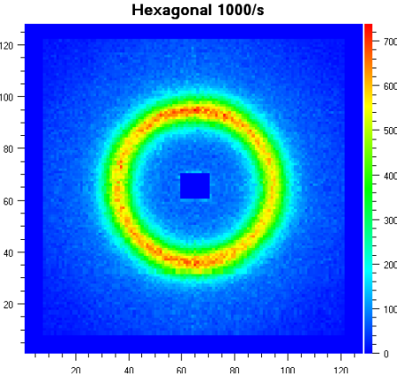
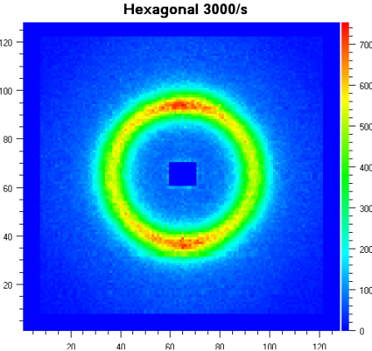
Shear Scans with SANS hexagonal

Slide 47
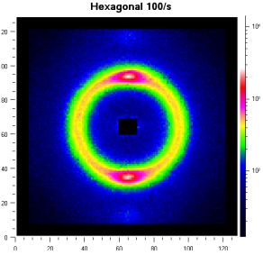
Comparison to Injected Microemulsion in GISANS Cell
shear
No Alingnment
Perfect Alignment
Lamellar Order
Near Surface

Slide 48
Comparison to Injected Microemulsion in GISANS Cell
shear
Silicon

Slide 49
Summary
Amphiphile
Condensation – Self Assembly
High Symmetry
Interactions
Concepts: * Aqueous Surfactant Systems
* Microemulsions
* (Polymeric Systems) not here
* (Mesoscopic Particles) (Ianus) not here
Actual research:
Surfaces
Mesoscopic Particles
Surfactants + Polymers

